Slide 1
Class 3: Research Reproducibility II
Kim Johnson

Slide 2
Lecture Outline
Library resources
Version control
GitHub

Slide 3
Learning Objectives
Understand what reproducible research is and steps to take to make your research reproducible
Be able to understand what version control is and how it can potentially make your life easier and make science better
Be able to create a Github account
Understand and implement some basic git version control operations and words (add, commit, status, log, origin, master, push, pull)

Slide 4
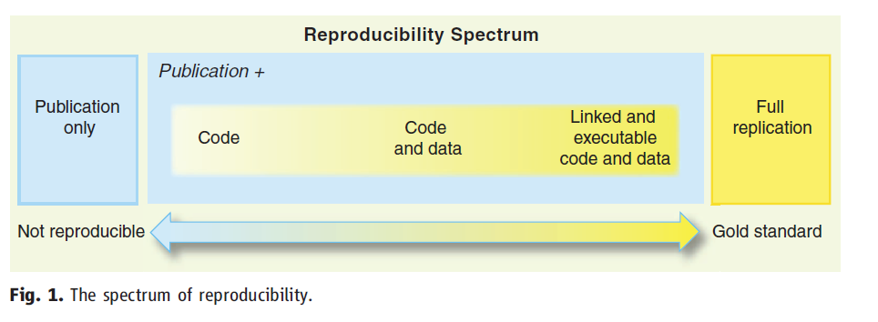
The reproducibility spectrum (From Peng reading)
Reproducibility spectrum

Slide 5
Version control
How many of you have worked on assignments where multiple versions of a project file were simultaneously being altered by different people?
Exchanging files by email?
Working on the wrong version and then having to add your changes to a different version?

Slide 6

FRUSTATION!

Slide 7
So what is version control?
(with credit to https://www.visualstudio.com/learn/what-is-version-control/)
Software for tracking changes you make to code or any files for that matter
In the old days and perhaps now, version control involved (involves) multiple versions of the same document on your computer with version numbers or dates.

Slide 8
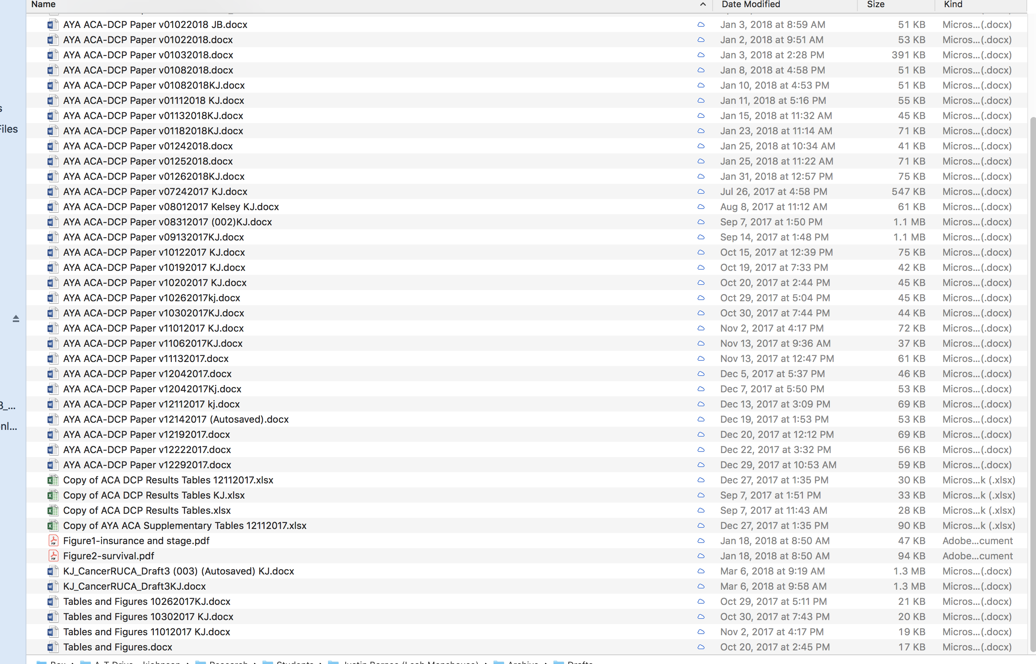
The only logical conclusion is that I am a file hoarder!

Slide 9
Version control system benefits
(with credit to https://www.visualstudio.com/learn/what-is-version-control/)
Manage all versions but you only see one at a time
Every version can have a log of changes made
You can go back to any version at any time (you never lose the work)
Facilitates collaborative coding
You have an archive of your changes to a particular file
Important for reproducible research!

Slide 10
Version control systems
Box!! (does not allow comment on what changed)
Google docs and sheets
CVS
SVN (subversion)
GIT (emerging star and harder to learn but we can do it!) **developed for plain text files but there are rich text file adaptations available
Mecurial
Bazaar
To read more: https://www.getfilecloud.com/blog/2015/02/top-5-open-source-version-control-tools-for-system-admins/#.WlZnw66nHAU

Slide 11
Git
Developed in 2005 by Linus Torvalds (claim to fame: Linux open source operating system creation)
Software that takes snapshots of files in a directory at points in time and keeps a retrievable record of plain text changes

Slide 12
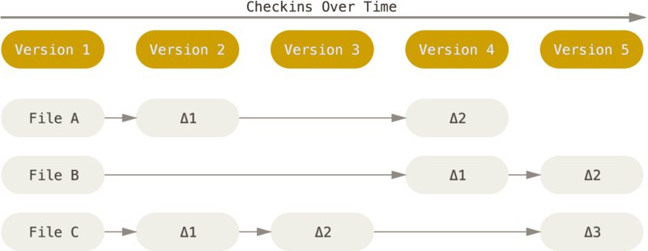
Snapshots of a directory over time

Slide 13
Two main types of Git
Command line interface (CLI, GitBash )
Graphical user interface (GUI, GitHub desktop)

Slide 14
What is the command line?
User issues “commands” to a program through lines of text in what is known as a shell (e.g. Unix, Bash is a Unix shell)
Has been around since the 1960s
According to Wikipedia: “Command-line interfaces to computer operating systems are less widely used by casual computer users, who favor graphical user interfaces or menu-driven interaction”
Other advantages (according to Wikipedia):
uses fewer system resources
faster than GUIs with experience
can keep a command line history (in contrast to GUIs, which are interactive)

Slide 15
Command prompts and arguments
Character that indicates the shell’s readiness to take commands (for Unix it is $)
Arguments follow the command prompt and tell the computer what to do

Slide 16
Git Bash is the command line shell for Git using Unix
Allows for local and remote version control (version control of files on your computer and Github or other remote server)
Puts a directory on your computer under version control and provides user with the ability to send version controlled files to a Github remote repository
Key steps to version controlling files:
adding a file for version tracking using git add
committing a tracked file with a message using git commit -m ‘my message’ (i.e. taking a snapshot)
pushing your version controlled files to a remote repository using git push remote origin master (note there are other ways to specify pushes)

Slide 17


Slide 18
What you need to do these exercises:
A GitHub account (will be created in the module)
Gitbash installed
GitHub desktop installed
Know the location of the terminal (MAC)

Slide 19
Lab
Go through module 5 as class https://coding2share.github.io/ReproducibilityToolkit/
Start HW3

Slide 20
For help with Git and Unix commands
Ask Us! (This is so cutting edge for public health and social work that Statlab probably won’t be able to help :))
Everything you need to know (and way more): https://git-scm.com/book/en/v2
Unix http://mally.stanford.edu/~sr/computing/basic-unix.html

